Slide 1

Hate crimes Distribution
Agustín Sánchez

Slide 2
What groups are more at-risk?
01
What race is the biggest offender?
02
What are the most dangerous states for the top 3 at-risk groups?
03

Slide 3
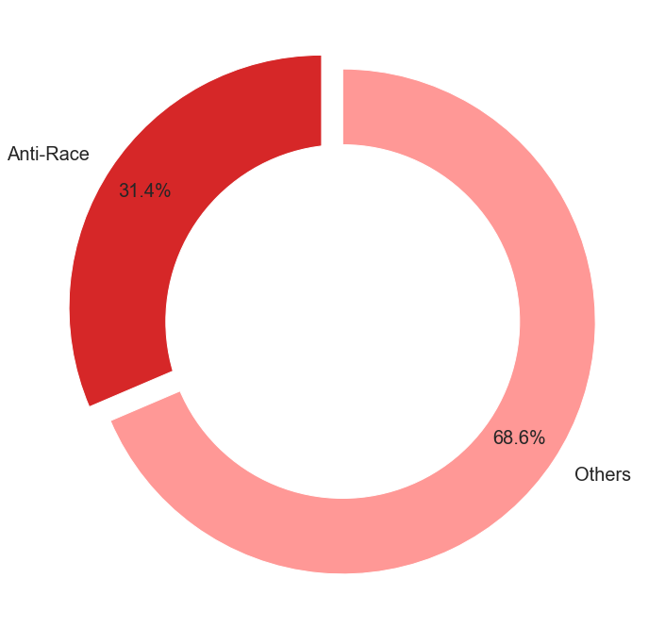
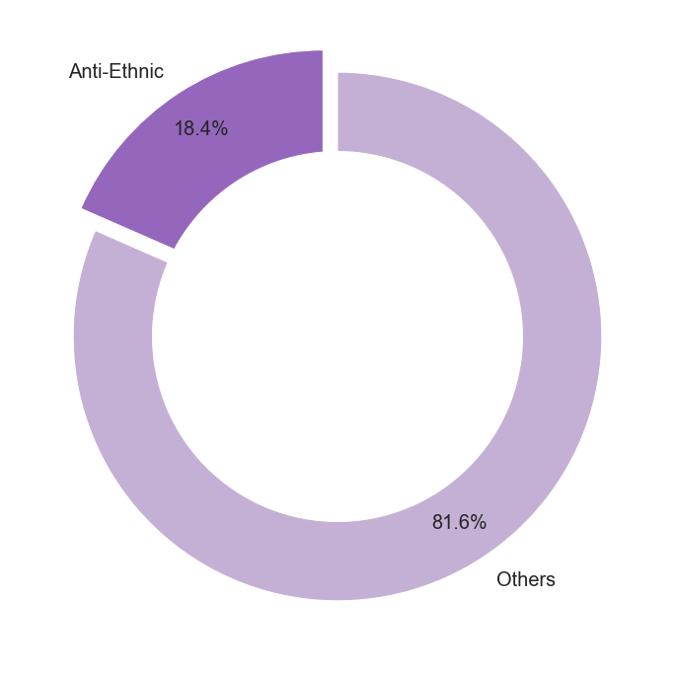
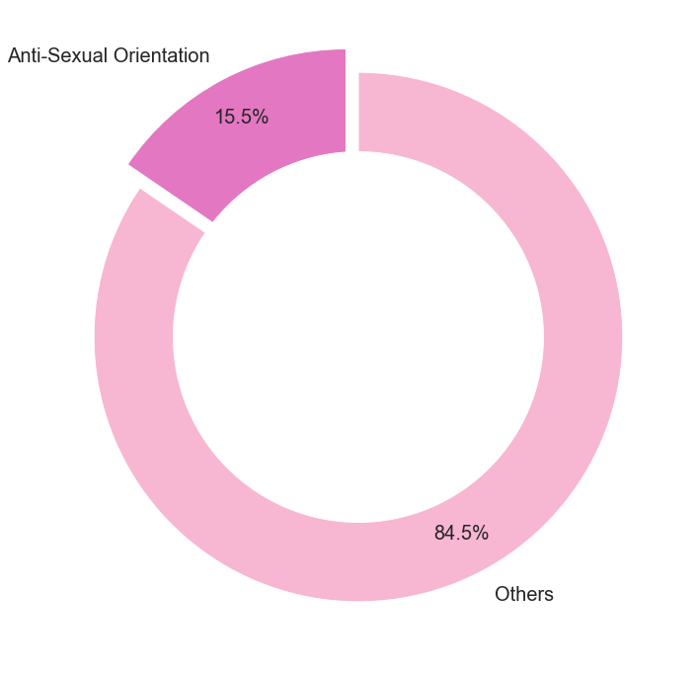
Hate Crimes % by Race/Ethnicity/Sexual Orientation
7,194
*
Hate crimes committed in 2018.
Data extracted from FBI Crime Data Explorer NIBRS database
*reported numbers

Slide 4
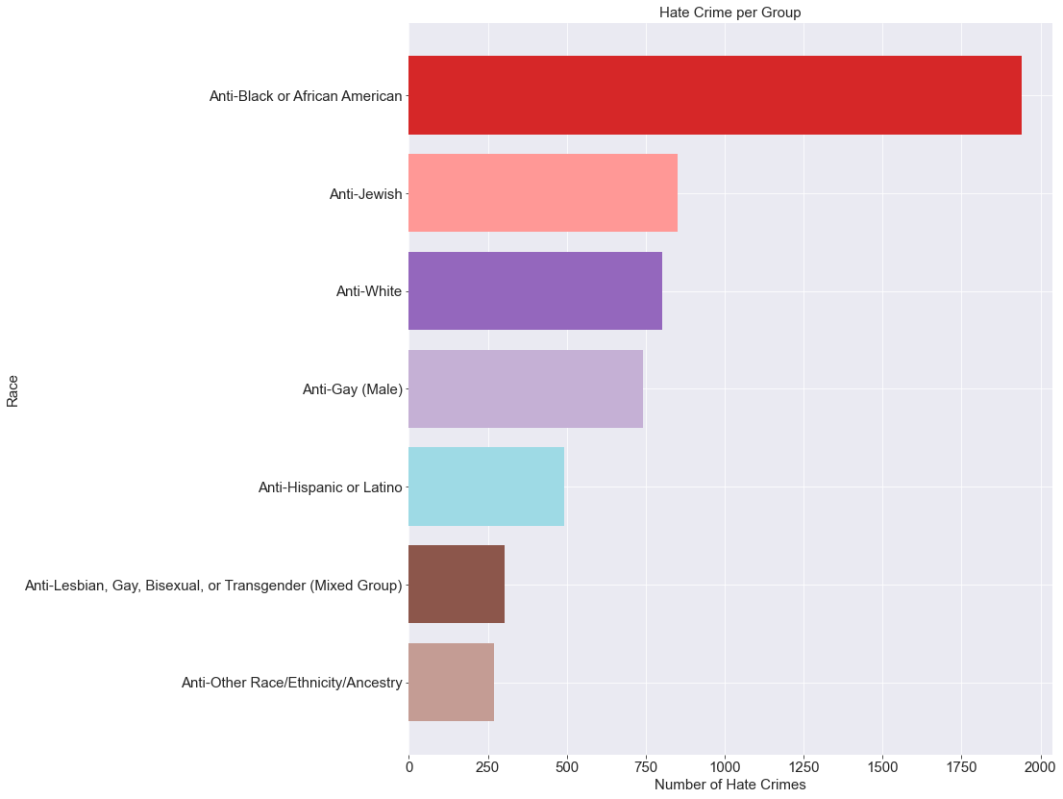
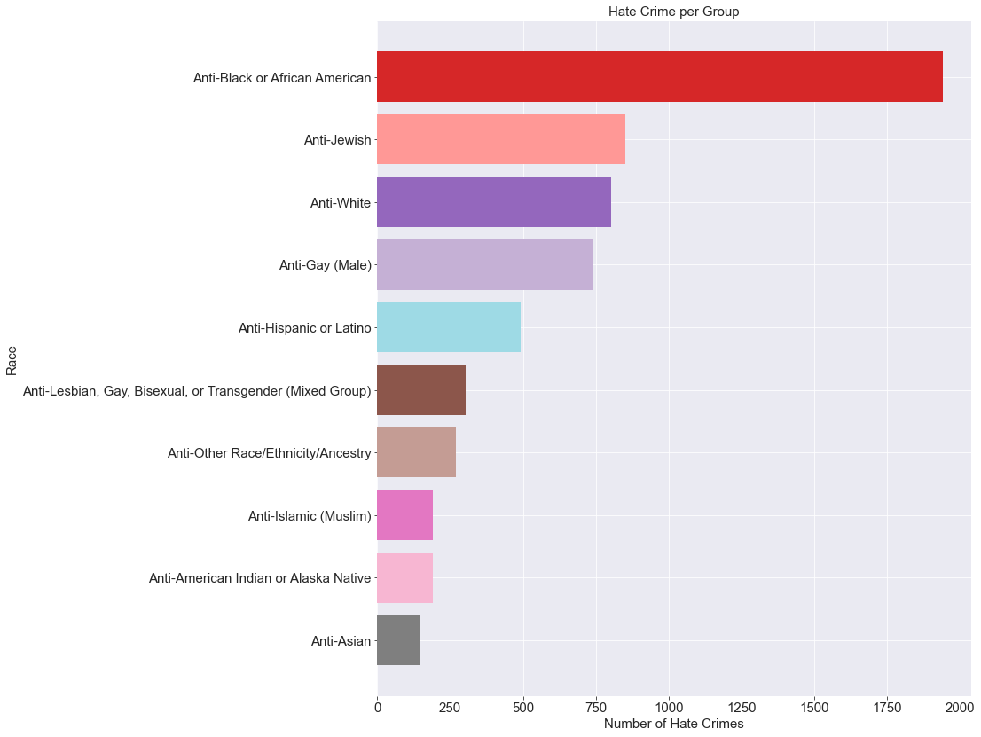




African Americans
are the highest
at-risk group overall.
Jewish people are
the highest at-risk
ethnic group.
Out of the
LGTQB group,
Gay males suffer
the most attacks.

Slide 5
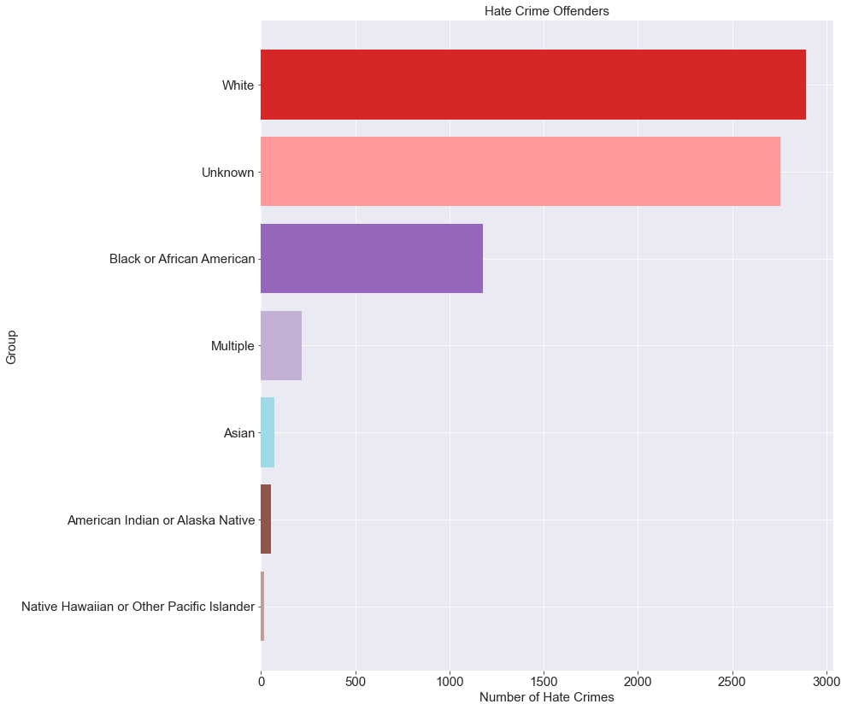

Whites commit
the most hate
crimes.
?
38% of the
offenders races
are unknown.

Slide 6
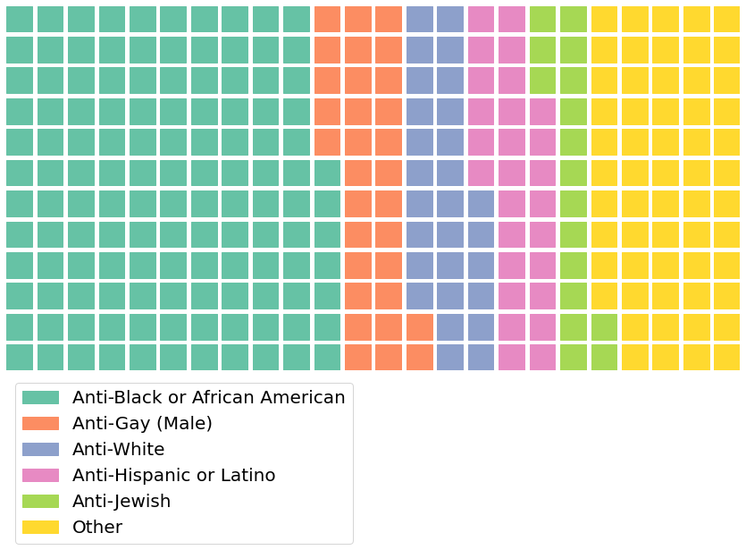
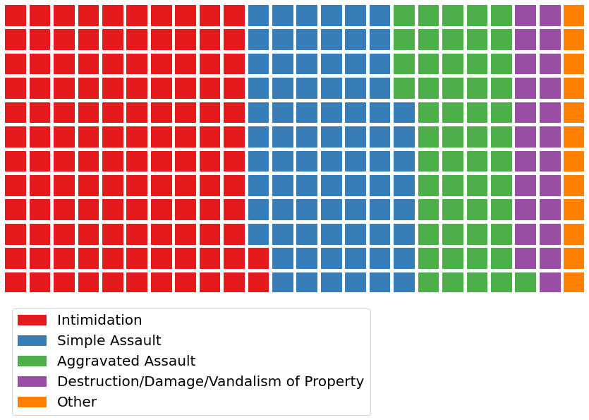
Distribution of Hate Crimes by Whites

Slide 7
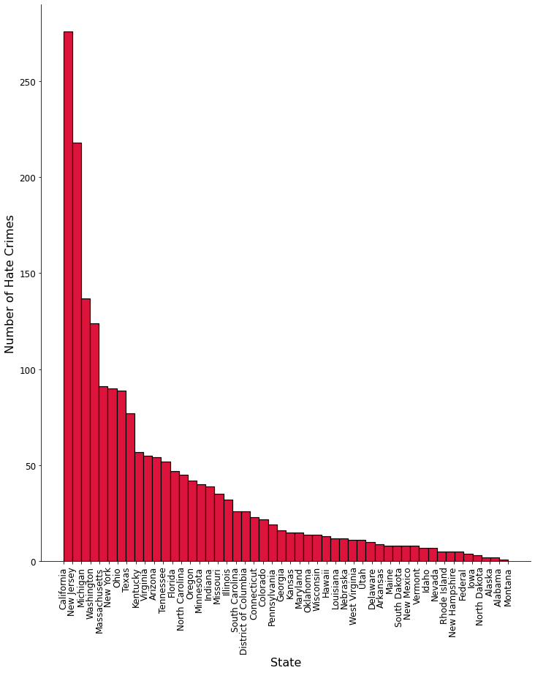
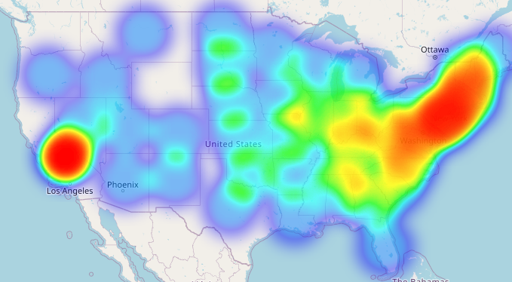

Hate crime distribution: African-Americans
16%
of attacks happen in California

Slide 8
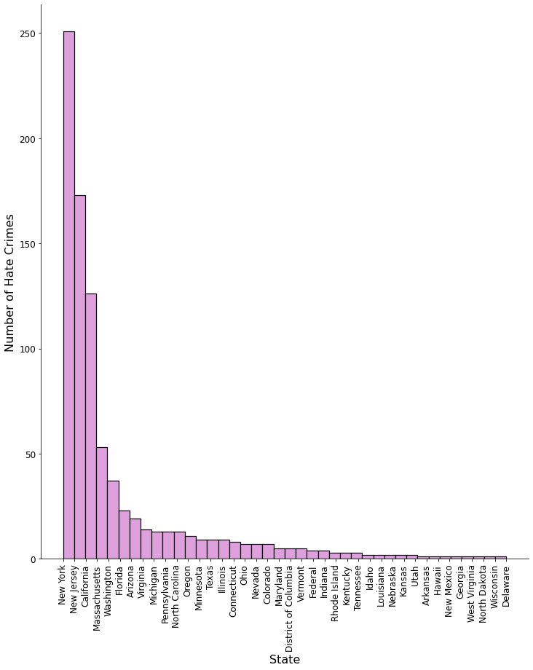
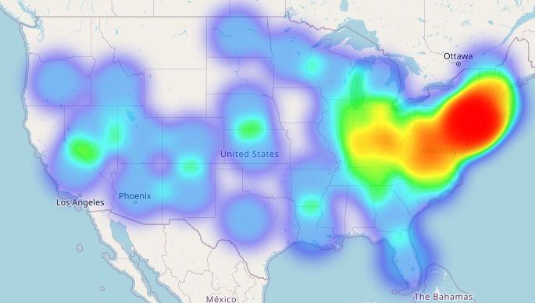

Hate crime distribution: Jewish
29%
of attacks happen in New York

Slide 9
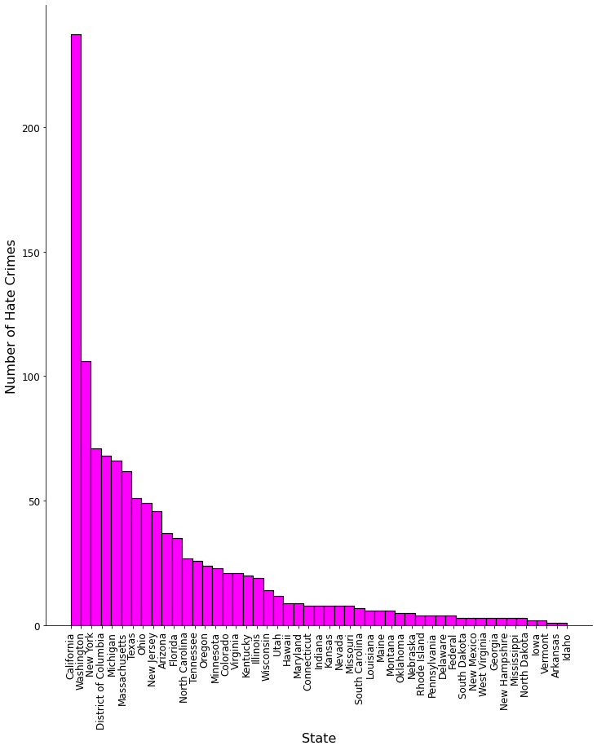
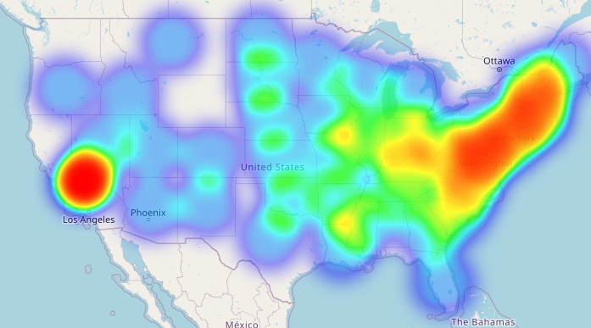
Hate crime distribution: LGTB+
20%
of attacks happen in California

